Slide 1
Probability Distributions and Introduction to Statistical Inference
bio5312 Fall2017
stephanie j. spielman, PhD

Slide 2
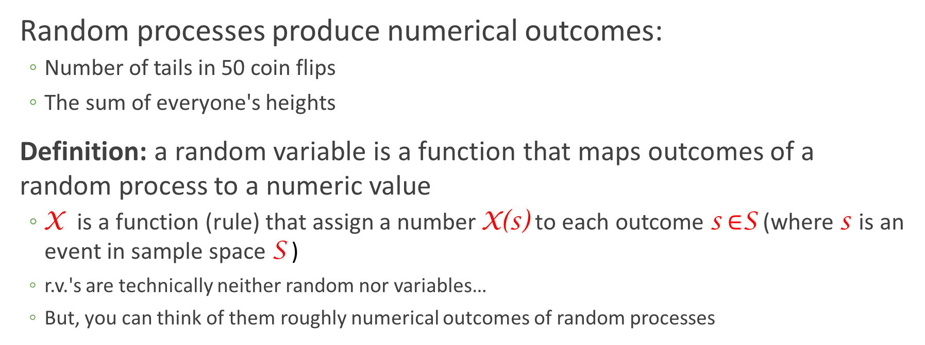
Random variable
Random processes produce numerical outcomes:
Number of tails in 50 coin flips
The sum of everyone's heights
Definition: a random variable is a function that maps outcomes of a random process to a numeric value
X is a function (rule) that assign a number X(s) to each outcome s $∈$S (where s is an event in sample space S )
r.v.'s are technically neither random nor variables…
But, you can think of them roughly numerical outcomes of random processes

Slide 3
Discrete vs continuous RV
Discrete random variables can take on (map to) a finite number of values
Continuous random variables can take on (map to) innumerable/infinite values

Slide 4
Expressing discrete random variables
Probability mass function (PMF)
Describes the values taken by a discrete r.v. X and its associated probabilities
Function that assigns, to any possible value x of a discrete r.v. X, the probability P(X = x)
PMF for rolling a fair die
P(X = x)
x

Slide 5
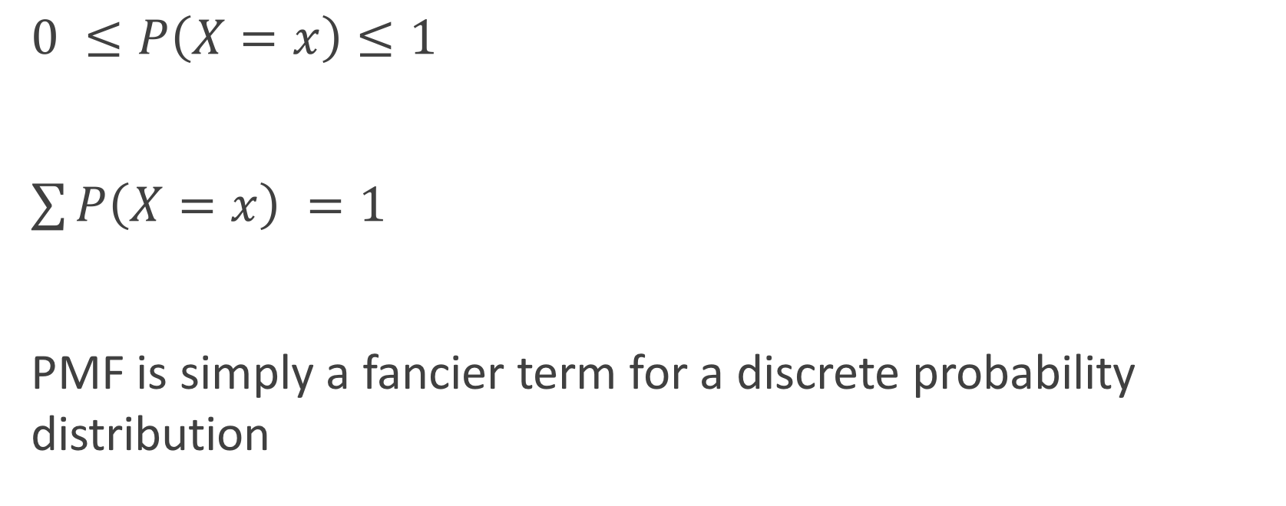
PMF properties
$0 ≤P\left(X=x\right)≤1$
$\sum{P\left(X=x\right) =1}$
PMF is simply a fancier term for a discrete probability distribution

Slide 6
Expressing discrete random variables
Cumulative distribution function (CDF)
Function defined, for a specific value x of a discrete r.v. X, as F(x) = P(X ≤ x)
CDF for rolling a fair die
P(X ≤ 4)
P(X ≤ 1)

Slide 7
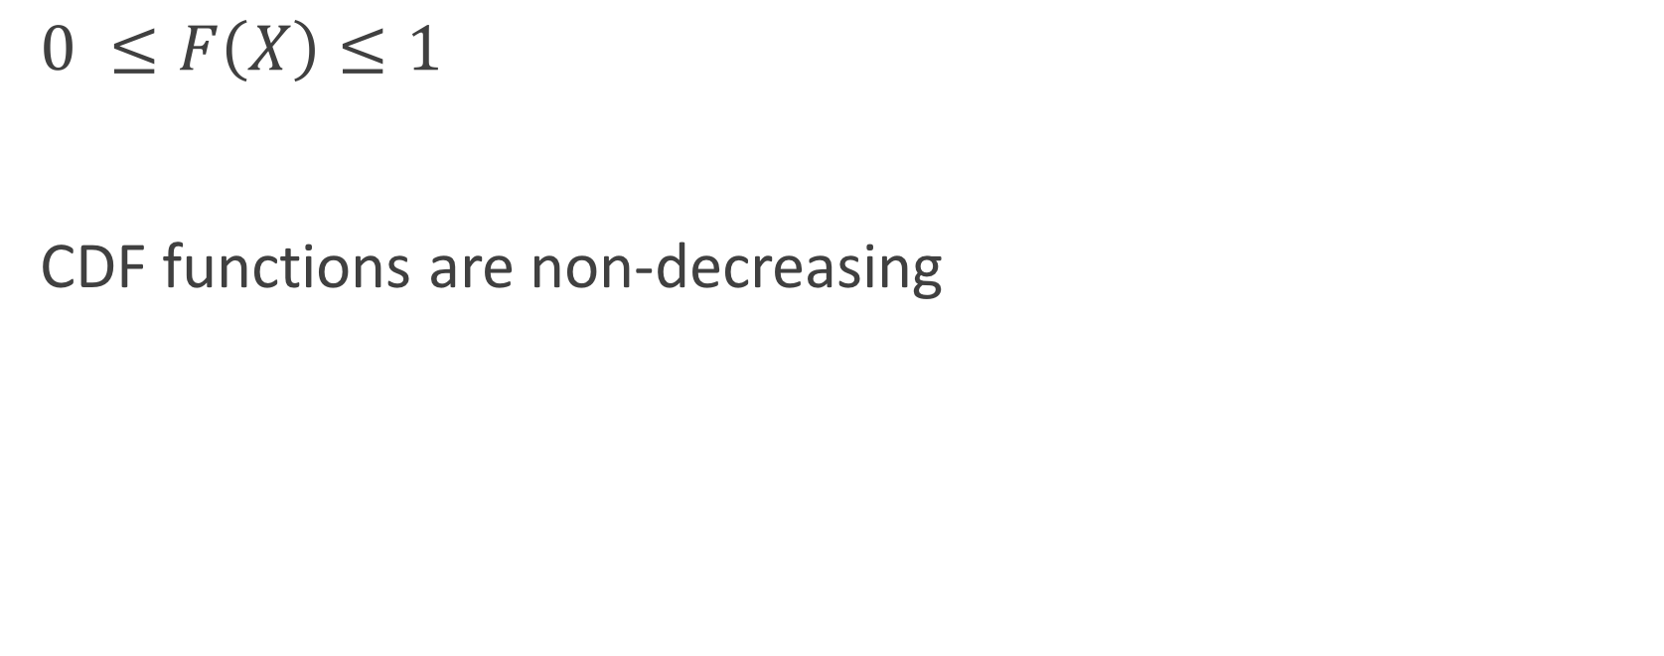
CDF properties
$0 ≤F\left(X\right)≤1$
CDF functions are non-decreasing

Slide 8
PMF vs CDF
PMF: What is the probability of event X?
CDF: What is the sum of probabilities for all events ≤ X?

Slide 9
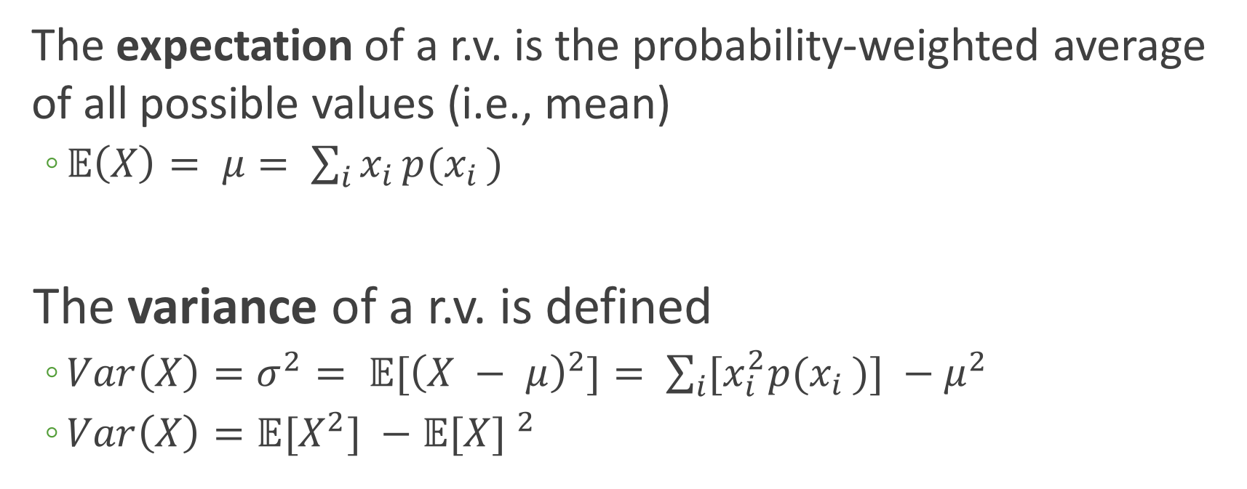
Expectation and spread of random variables
The expectation of a r.v. is the probability-weighted average of all possible values (i.e., mean)
$𝔼\left(X\right)= μ= \sum_{i}{x_{i }{p(x}_{i })}$
The variance of a r.v. is defined
$Var\left(X\right)=σ^{2}= 𝔼{[\left(X − μ\right)}^{2}]= \sum_{i}{[x_{i}^{2}{p(x}_{i })}] −μ^{2}$
$Var\left(X\right)=𝔼{[X}^{2}] −{𝔼[X] }^{2}$

Slide 10
Example: The Binomial distribution
The binomial distribution describes the probability of obtaining k successes in n Bernoulli trials, where the probability of success for each trial is constant at p
A Bernoulli trial has a binary outcome (success/fail, true/false, yes/no), and P(success) = p is the same for all realizations of the trial

Slide 11
The BInS conditions
To be binomially distributed, must satisfy the following:
Binary outcomes
Independent trials (outcomes do not influence each other)
n is fixed before the trials begin
Same probability of success, p, for all trials

Slide 12
Is it binomial?
A bag contains 10 balls, 7 red and 3 green.
Situation 1: You draw 5 balls from the bag, noting the ball color each time and then returning it to the bag.
Situation 2: You draw 5 balls from the bag, retaining each drawn ball for safe-keeping so you can play catch at any moment.
Situation 3: You keep drawing balls, with replacement, until you have drawn 4 red balls.
Yes!
No ☹
No ☹

Slide 13
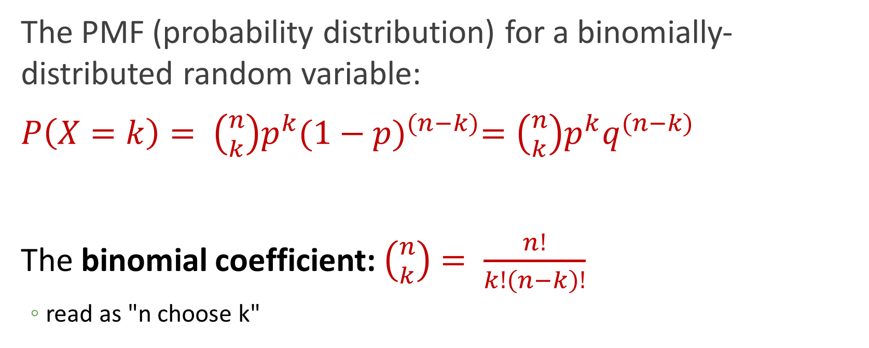
The binomial distribution
The PMF (probability distribution) for a binomially-distributed random variable:
$P\left(X=k\right)= \left({n \atop k}\right)p^{k}{(1−p)}^{(n−k)}=\left({n \atop k}\right)p^{k}q^{(n−k)}$
The binomial coefficient: $\left({n \atop k}\right)= \frac{n!}{k!\left(n−k\right)!}$
read as "n choose k"

Slide 14
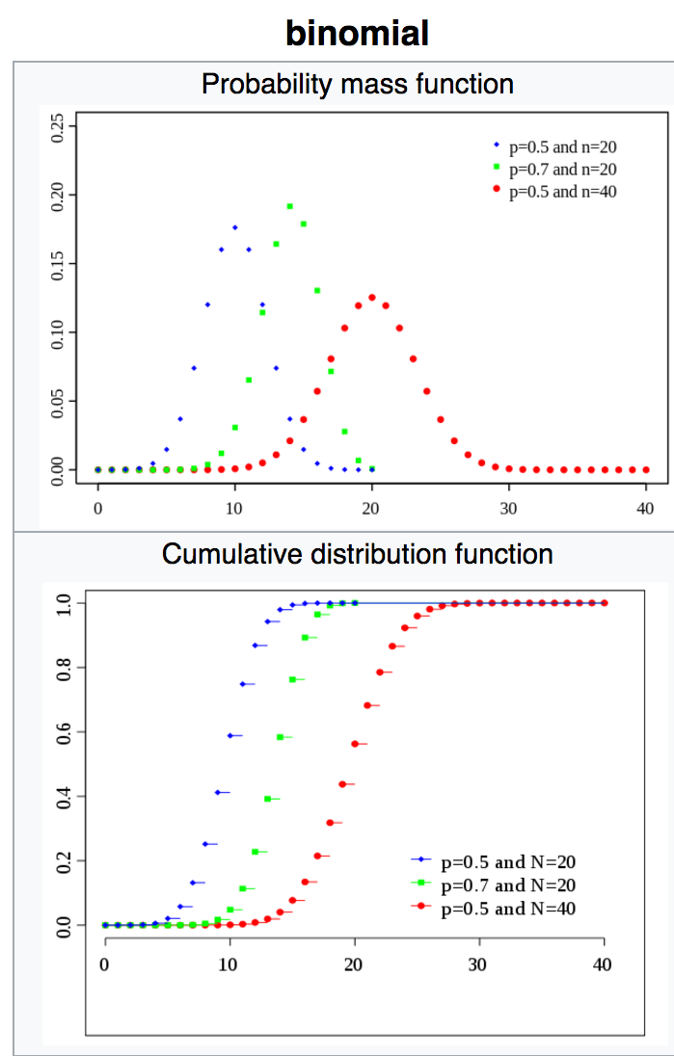
Wikipedia weighs in

Slide 15
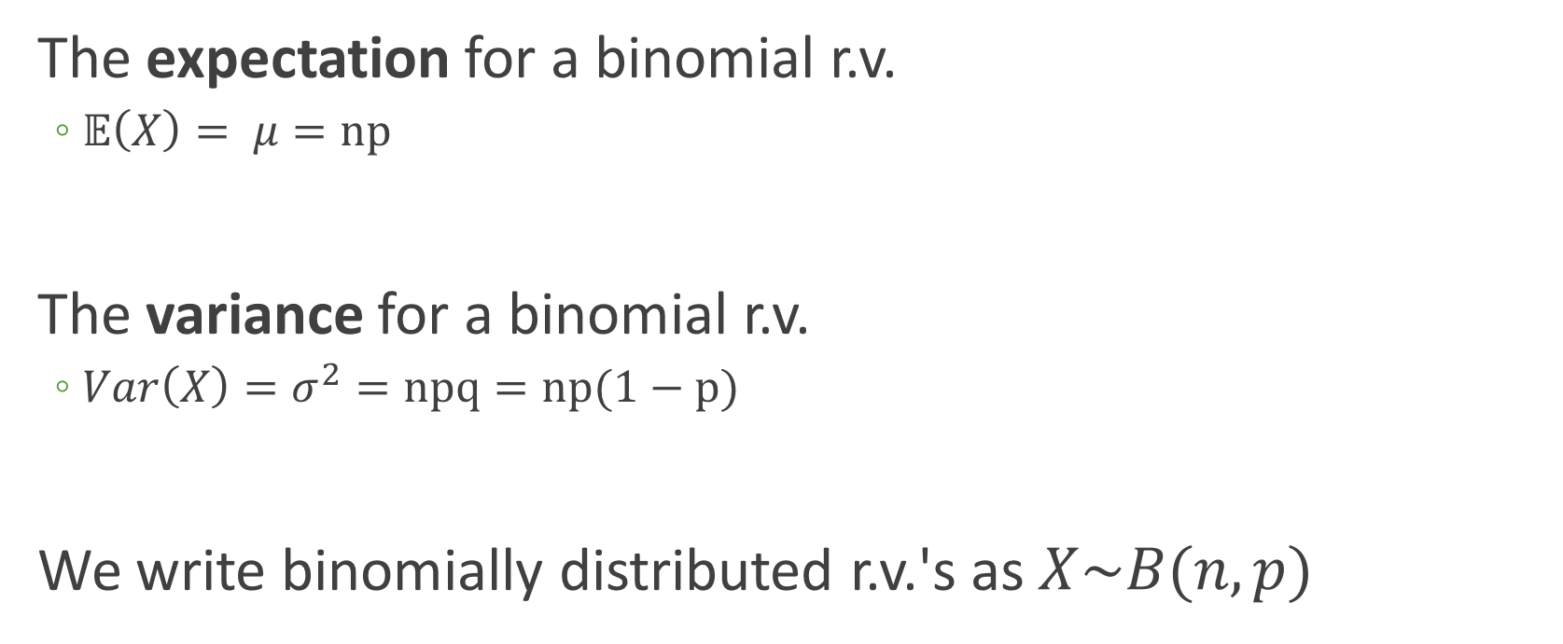
The binomial distribution
The expectation for a binomial r.v.
$𝔼\left(X\right)= μ=np$
The variance for a binomial r.v.
$Var\left(X\right)=σ^{2}=npq=np(1−p)$
We write binomially distributed r.v.'s as $X\sim B(n,p)$

Slide 16
Example: Playing with a binomial rv
Each child born to a particular set of parents has a 25% probability of having blood type O. Assume the parents had five children.
Here, n = 5 and p = 0.25, meaning we define Type O as "success", and not Type O as "failure". → X~B(5, 0.25)
Tasks:
Compute expectation and variance
Visualize PMF
Visualize CDF
Make some calculations…

Slide 17
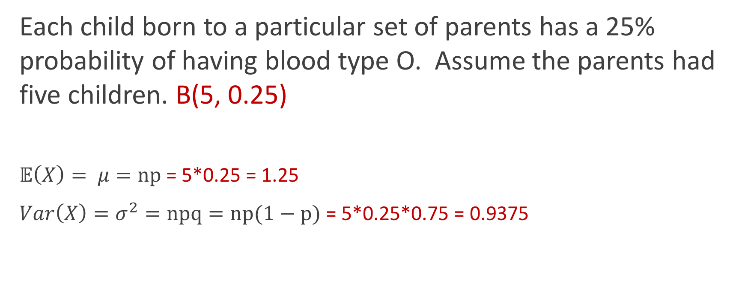
Expectation and variance
Each child born to a particular set of parents has a 25% probability of having blood type O. Assume the parents had five children. B(5, 0.25)
$𝔼\left(X\right)= μ=np$ = 5*0.25 = 1.25
$Var\left(X\right)=σ^{2}=npq=np(1−p)$ = 5*0.25*0.75 = 0.9375

Slide 18
Visualize the PMF

Slide 19
?distributions
Distributions in the stats package
Description:
Density, cumulative distribution function, quantile function and
random variate generation for many standard probability
distributions are available in the ‘stats’ package.
Details:
The functions for the density/mass function, cumulative
distribution function, quantile function and random variate
generation are named in the form ‘dxxx’, ‘pxxx’, ‘qxxx’ and ‘rxxx’
respectively.
For the beta distribution see ‘dbeta’.
For the binomial (including Bernoulli) distribution see ‘dbinom’.
For the Cauchy distribution see ‘dcauchy’.
For the chi-squared distribution see ‘dchisq’.

Slide 20
Distribution functions, generally
Function | Purpose | Binomial version
dxxx() | Probability distribution | dbinom(x, size, prob)
pxxx() | CDF | pbinom(q, size, prob)
rxxx() | Generate random numbers from given distribution | rbinom(n, size, prob)
qxxx() | Quantile: Inverse of pxxx() | qbinom(p, size, prob)

Slide 21
Binomial distribution functions
Binomial function | Example | Output
dbinom(x, size, prob) | dbinom(2, 5, 0.25) | Prob of obtaining 2 successes in 5 trials, where p=0.25 → 0.263
pbinom(q, size, prob) | pbinom(2, 5, 0.25) | Prob of obtaining ≤2 successes in 5 trials, where p=0.25 → 0.896
rbinom(n, size, prob) | rbinom(100, 5, 0.25) | Generate 100 k values from this binomial dist. → 100 from {0,1,2,3,4}
qbinom(p, size, prob) | qbinom(0.896, 5, 0.25) | Smallest value x where F(x) >= p* → 2 *not prob success, just a prob

Slide 22
Making the PMF
> ## Use dbinom() to get the PMF values
p = 0.25
n = 5
k0 <- dbinom(0, 5, 0.25) ## Prob of 0 successes, aka no children are Type O
k1 <- dbinom(1, 5, 0.25) ## Prob of 1 success, aka only 1 child is Type O
## Advanced:
library(purrr)
map_dbl(0:5, dbinom, 5, 0.25)
[1] 0.2373046875 0.3955078125 0.2636718750 0.0878906250 0.0146484375
[6] 0.0009765625

Slide 23
Making the PMF
## data frame (tibble) of probabilities for PMF
> data.pmf <- tibble(k = 0:5, prob = c(0.236623, 0.396, 0.264, 0.0879, 0.0145, 0.000977))
> data.pmf
# A tibble: 6 x 2
k prob
<int> <dbl>
1 0 0.236623
2 1 0.396000
3 2 0.264000
4 3 0.087900
5 4 0.014500
6 5 0.000977
## Equivalent
data.pmf <- tibble(k = 0:5, prob = map_dbl(0:5, dbinom, 5, 0.25))

Slide 24
Making the PMF uses a different *stat*
> ggplot(data.pmf, aes(x = k, y=prob))+ geom_bar( stat="identity" ) +
xlab("Number of kids") + ylab("Probability Type O")

Slide 25
Tweaking the x-axis
> ggplot(data.pmf, aes(x = k, y=prob))+ geom_bar( stat="identity" ) +
ylab("Probability Type O") +
scale_x_continuous(name = "Number of kids", breaks = 0:5)

Slide 26
Adding some text
> ggplot(data.pmf, aes(x = k, y=prob))+ geom_bar( stat="identity" ) +
ylab("Probability Type O") +
scale_x_continuous(name = "Number of kids", breaks = 0:5) +
geom_text(aes(x = k, y= prob + 0.01, label = prob))

Slide 27
Visualize the CDF
> binom.sample <- tibble(x = rbinom(1000, 5, 0.25))
> ggplot(binom.sample, aes(x=x)) + stat_ecdf() +
xlab("# Type O kids") + ylab("Cumulative probability")

Slide 28
Solving for probabilities
Each child born to a particular set of parents has a 25% probability of having blood type O. Assume the parents had five children. B(5, 0.25)
What is the probability that exactly 2 children were Type O?
> dbinom(2, 5, 0.25)
[1] 0.2636719

Slide 29
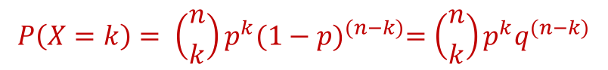
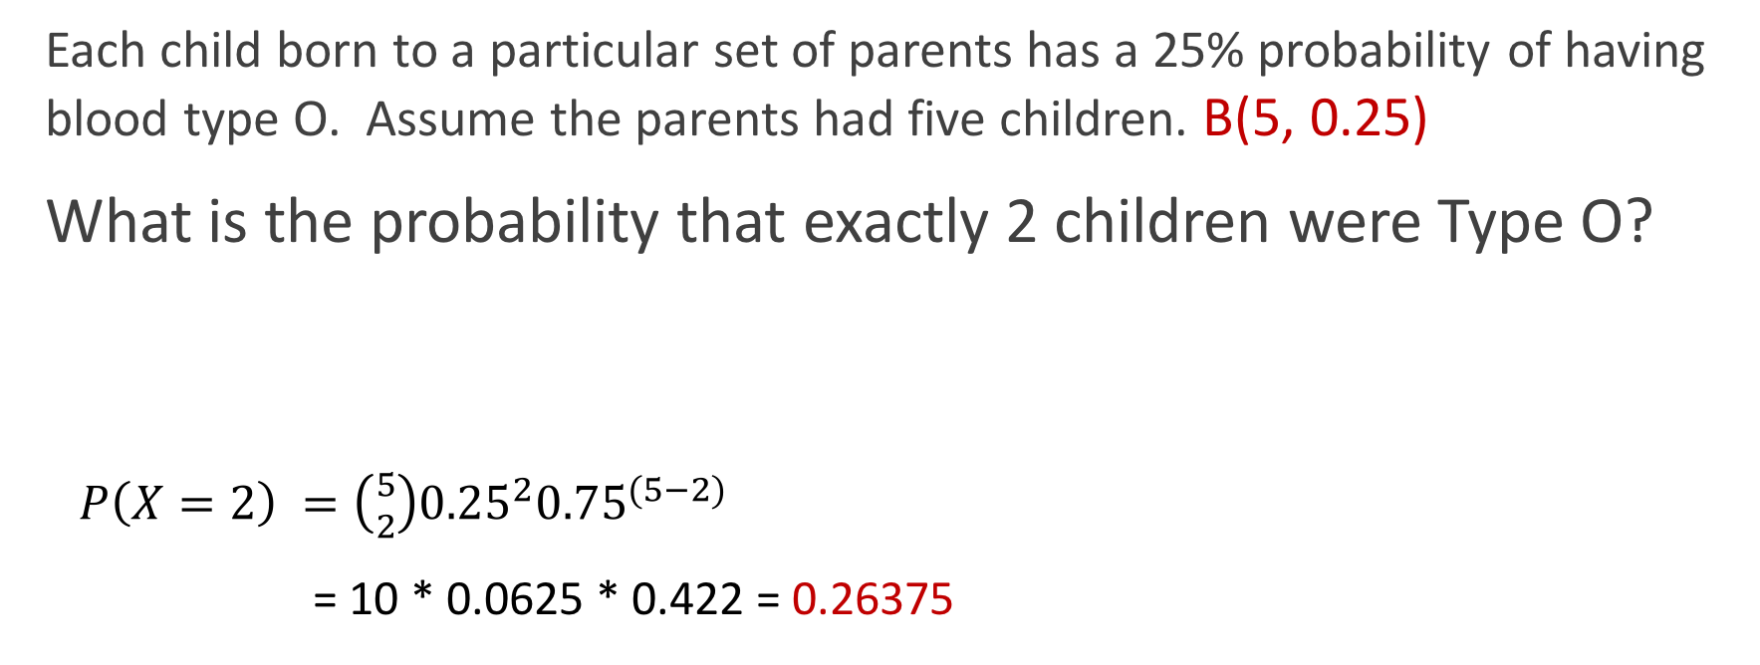
Solving for probabilities
Each child born to a particular set of parents has a 25% probability of having blood type O. Assume the parents had five children. B(5, 0.25)
What is the probability that exactly 2 children were Type O?
$P\left(X=2\right) =\left({5 \atop 2}\right){0.25}^{2}{0.75}^{(5−2)}$
= 10 * 0.0625 * 0.422 = 0.26375
$$P\left(X=k\right)= \left({n \atop k}\right)p^{k}{(1−p)}^{(n−k)}=\left({n \atop k}\right)p^{k}q^{(n−k)}$$

Slide 30
Solving for probabilities
B(5, 0.25)
What is the probability that 2 or fewer children were Type O?
> pbinom(2, 5, 0.25)
[1] 0.8964844

Slide 31
Solving for probabilities
B(5, 0.25)
What is the probability that 2 or fewer children were Type O?
> dbinom(0, 5, 0.25) + dbinom(1, 5, 0.25) + dbinom(2, 5, 0.25)
[1] 0.8964844

Slide 32
Solving for probabilities
B(5, 0.25)
What is the probability that more than 2 children (ie either 3, 4, or 5) were Type O?
> 1 - pbinom(2, 5, 0.25)
[1] 0.1035156

Slide 33
Solving for probabilities
B(5, 0.25)
What is the probability that more than 2 children (ie either 3, 4, or 5) were Type O?
> dbinom(3, 5, 0.25) + dbinom(4, 5, 0.25) + dbinom(5, 5, 0.25)
[1] 0.1035156

Slide 34
BREATHE

Slide 35
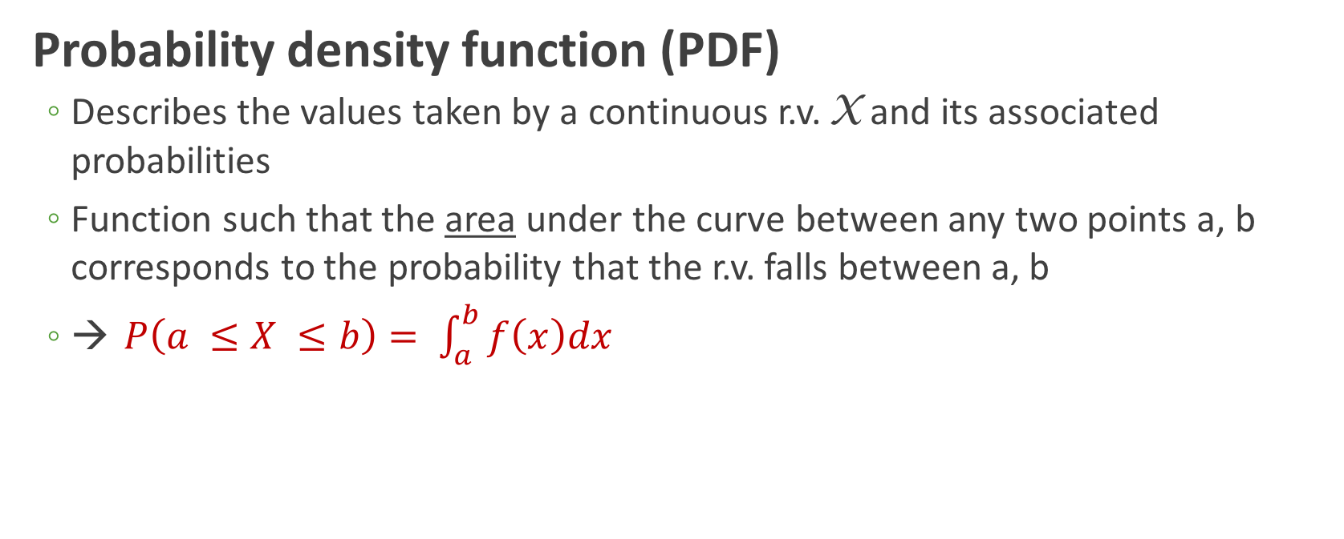
Expressing continuous random variables
Probability density function (PDF)
Describes the values taken by a continuous r.v. X and its associated probabilities
Function such that the area under the curve between any two points a, b corresponds to the probability that the r.v. falls between a, b
→ $P\left(a ≤X ≤b\right)= \int_{a}^{b}{f\left(x\right)dx}$

Slide 36
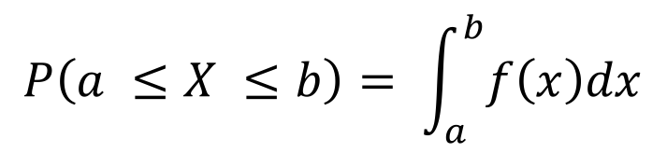
PDF
$$P\left(a ≤X ≤b\right)= \int_{a}^{b}{f\left(x\right)dx}$$

Slide 37
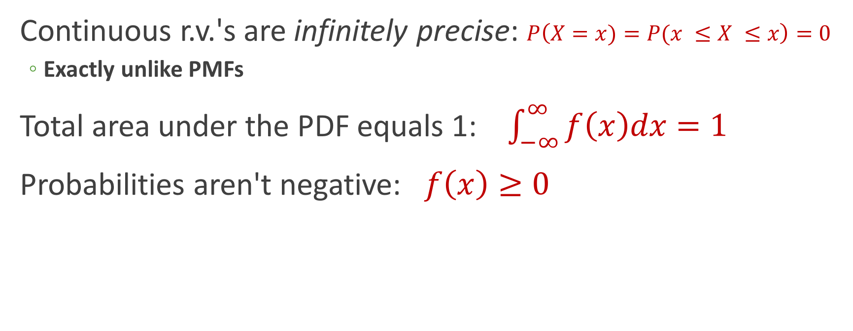
PDF properties
Continuous r.v.'s are infinitely precise: $P\left(X=x)=P(x ≤X ≤x\right)=0$
Exactly unlike PMFs
Total area under the PDF equals 1: $\int_{−∞}^{∞}{f\left(x\right)dx=1}$
Probabilities aren't negative: $f\left(x\right)≥0$

Slide 38
Expressing continuous random variables
Cumulative distribution function (CDF)
Function defined, for a specific value x of a continuous r.v. X, as F(x) = P(X ≤ x)
(mostly) the same as for discrete

Slide 39
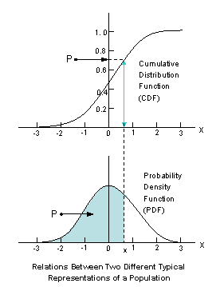
Relationship between PDF and CDF

Slide 40
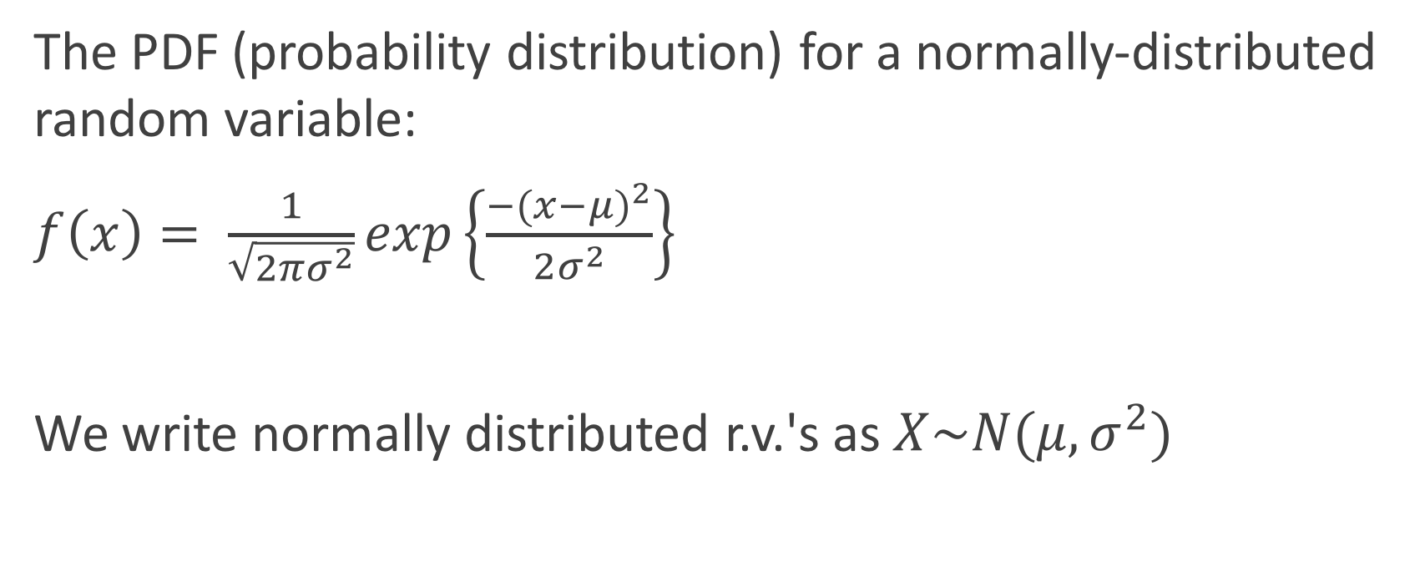
Jumping right in: Normal distribution
The PDF (probability distribution) for a normally-distributed random variable:
$f\left(x\right)= \frac{1}{\sqrt{2πσ^{2}}}exp\left\{\frac{{−(x−μ)}^{2}}{2σ^{2}}\right\}$
We write normally distributed r.v.'s as $X\sim N(μ, σ^{2})$
It's gross, everyone knows it, and you will be neither plugging nor chugging with this equation

Slide 41
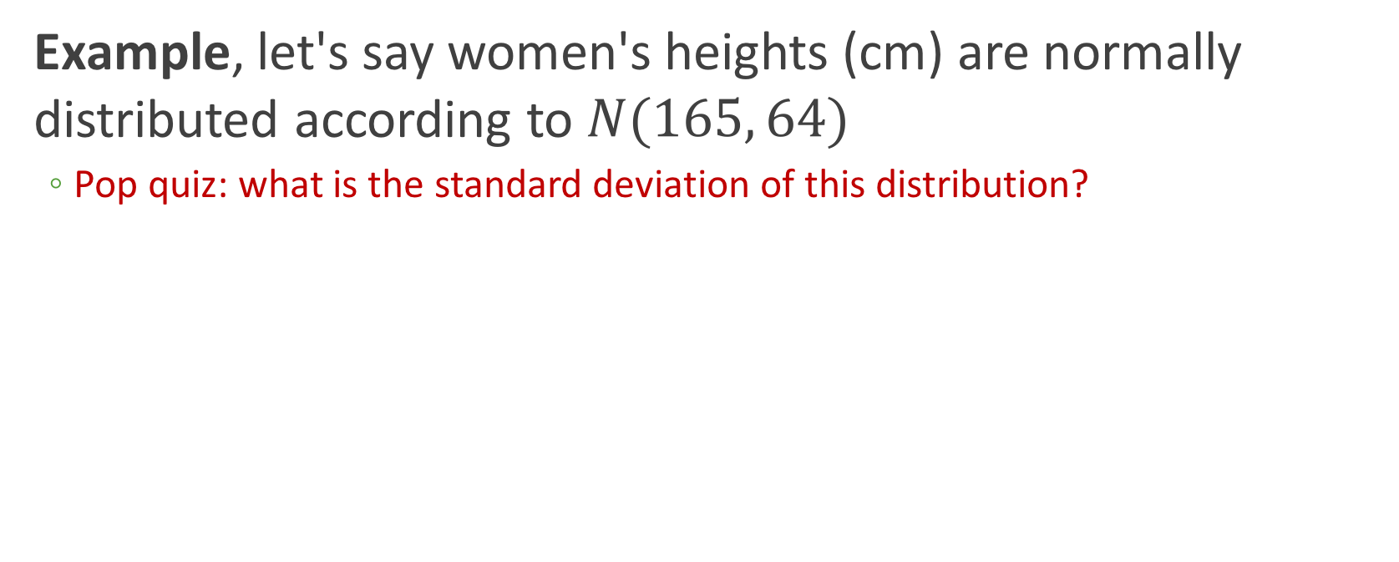
PDF of normal distribution
Example, let's say women's heights (cm) are normally distributed according to $N(165, 64)$
Pop quiz: what is the standard deviation of this distribution?

Slide 42
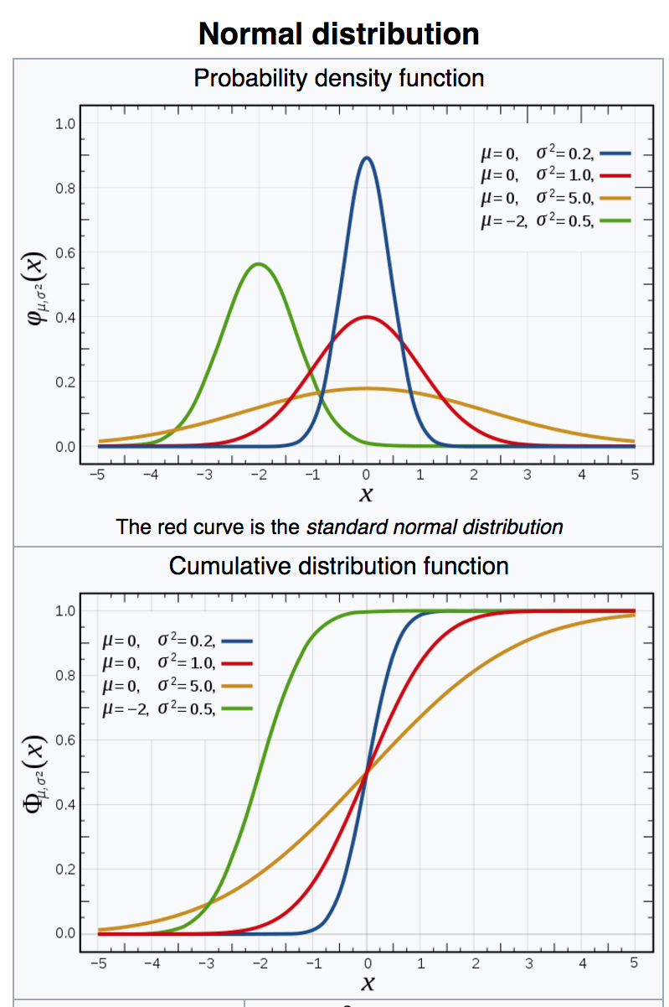
Wikipedia weighs in

Slide 43
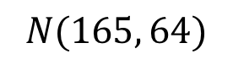
Making the PDF
Another "interesting" hack:
> plot.range <- tibble(x = c(165 - 32, 165 + 32))
> ggplot(plot.range, aes(x=x)) +
stat_function(fun = dnorm, args=list(mean=164, sd=8))
$$N(165, 64)$$

Slide 44
Making the CDF
> data.cdf <- tibble(x = rnorm(10000, 164, 8))
> ggplot(data.cdf, aes(x=x)) + stat_ecdf()

Slide 45
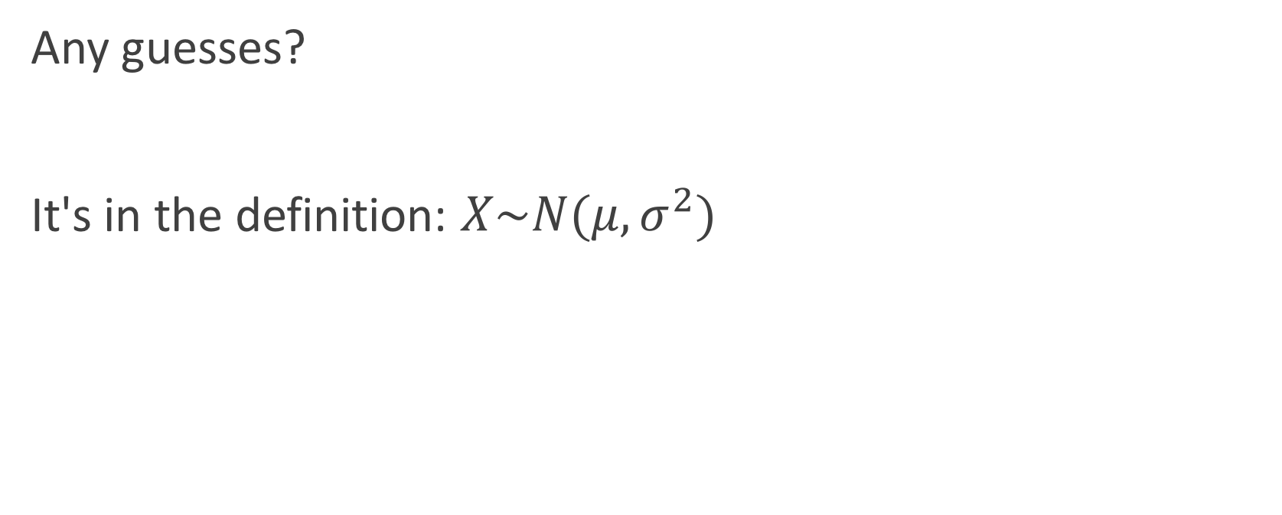
Expectation and variance
Any guesses?
It's in the definition: $X\sim N(μ, σ^{2})$

Slide 46
Working with the normal distribution
Types of questions one can ask:
What is the probability that a randomly-chosen woman is taller than 158 cm?
What is the probability that a randomly-chosen woman is between 163—170 cm tall?
What is the probability that a randomly-chosen woman is shorter than 167 cm?
What is the probability that a randomly-chosen woman is 168 cm tall?

Slide 47
Working with the normal distribution
Types of questions one can ask:
What is the probability that a randomly-chosen woman is taller than 158 cm?
What is the probability that a randomly-chosen woman is between 163—170 cm tall?
What is the probability that a randomly-chosen woman is shorter than 167 cm?
What is the probability that a randomly-chosen woman is 168 cm tall?

Slide 48
Properties of the normal distribution
Symmetric around the mean
Mean = median = mode
Inflection points

Slide 49
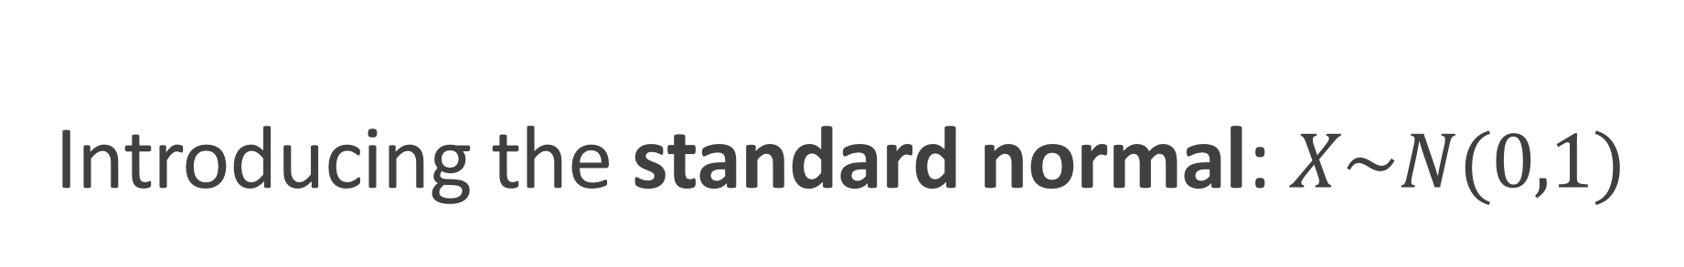
Introducing the standard normal: $X\sim N(0,1)$
𝜇 = 0
σ = 1
These are Z-scores

Slide 50

Standard Normal $X\sim N(0,1)$

Slide 51

PDF and CDF of $X\sim N(0,1)$
If the shaded grey area = 0.977, what is x?

Slide 52
Standard Normal $X\sim N(0,1)$
Due to symmetry, P(X ≤ -x) = 1 - P(X ≤ x)

Slide 53
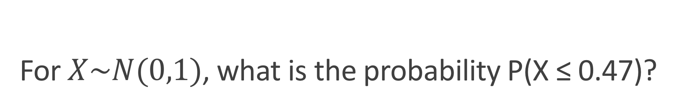
For $X\sim N(0,1)$, what is the probability P(X ≤ 0.47)?
# CDF: P(X <= 0.47)
> pnorm(0.47)
[1] 0.6808225

Slide 54
Normal distribution functions
Normal function | Meaning
dnorm(x) | Density at X=x
pnorm(q) | P(X <= x)
rnorm(n) | Generate n random draws from N(0,1)
qnorm(p) | Obtain x from given CDF area: qnorm(0.6808225) = 0.47

Slide 55
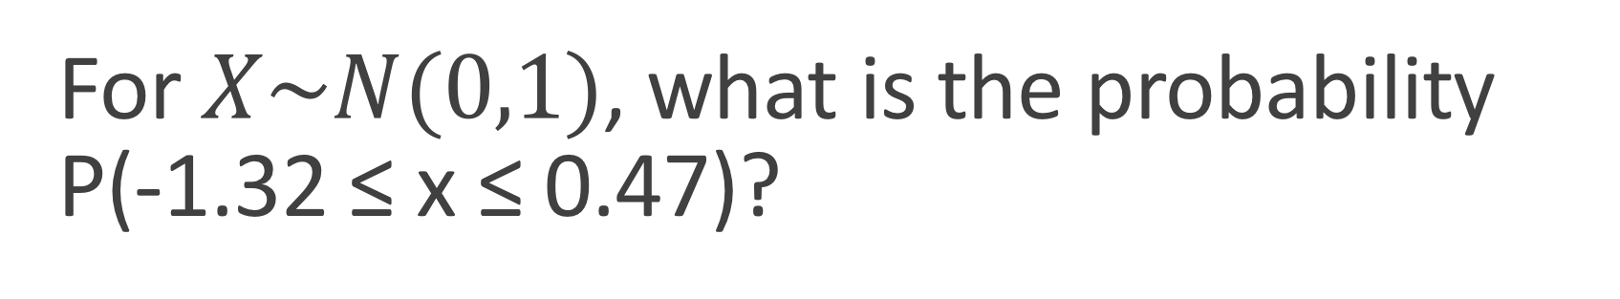
For $X\sim N(0,1)$, what is the probability P(-1.32 ≤ x ≤ 0.47)?

Slide 56
For $X\sim N(0,1)$, what is the probability P(-1.32 ≤ x ≤ 0.47)?
=
-
# P(X <= 0.47)
> pnorm(0.47)
[1] 0.6808225
# P(X <= -1.32)
> pnorm(-1.32)
[1] 0.09341751
0.587405

Slide 57
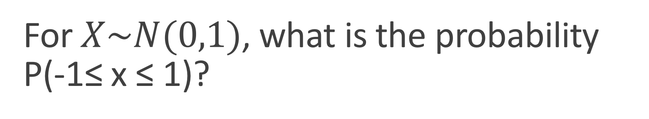
For $X\sim N(0,1)$, what is the probability P(-1≤ x ≤ 1)?
AKA probability of being within 1 standard deviation of mean?
~0.68

Slide 58
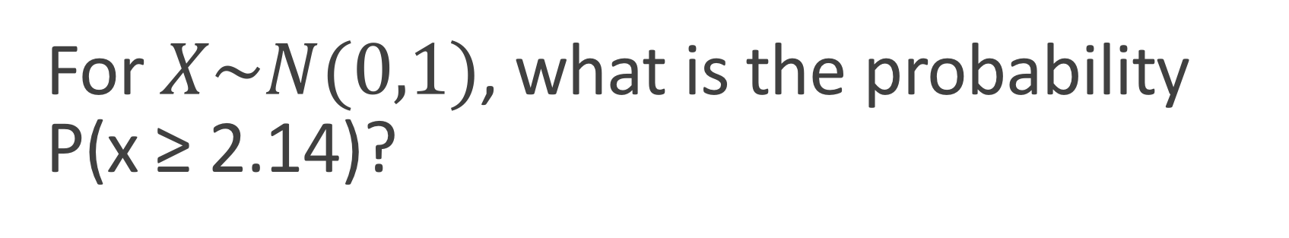
For $X\sim N(0,1)$, what is the probability P(x ≥ 2.14)?
## Two approaches:
> 1 - pnorm(2.14)
[1] 0.01617738
> pnorm(-2.14)
[1] 0.01617738

Slide 59
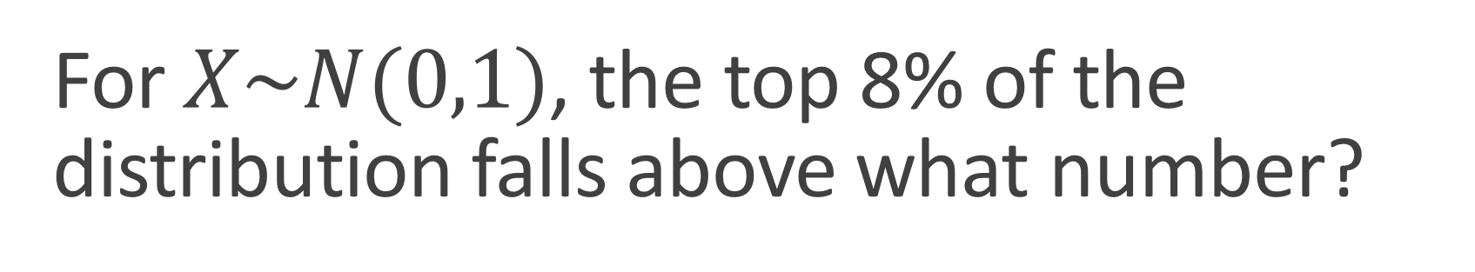
For $X\sim N(0,1)$, the top 8% of the distribution falls above what number?
> qnorm(1 - 0.08)
[1] 1.405072
> -1 * qnorm(0.08)
[1] 1.405072
Area=0.08
???

Slide 60
Historical consideration of z-scores

Slide 61
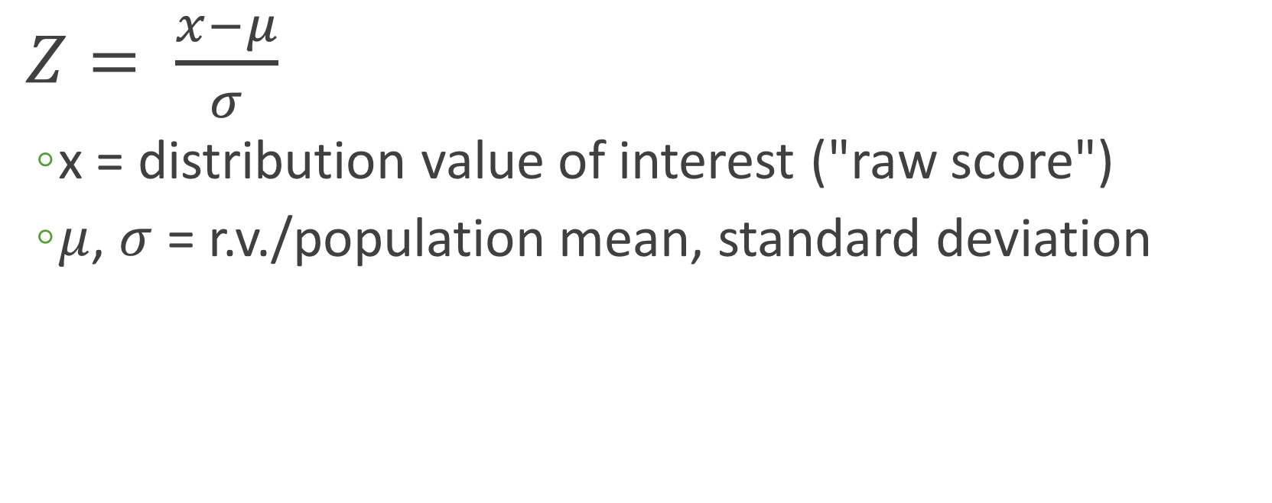
Re-scaling to standard normal to compare distributions
$Z= \frac{x−μ}{σ}$
x = distribution value of interest ("raw score")
$μ$, $σ$ = r.v./population mean, standard deviation

Slide 62
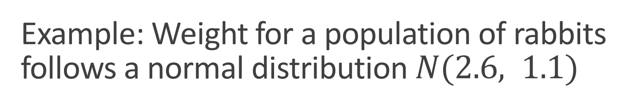
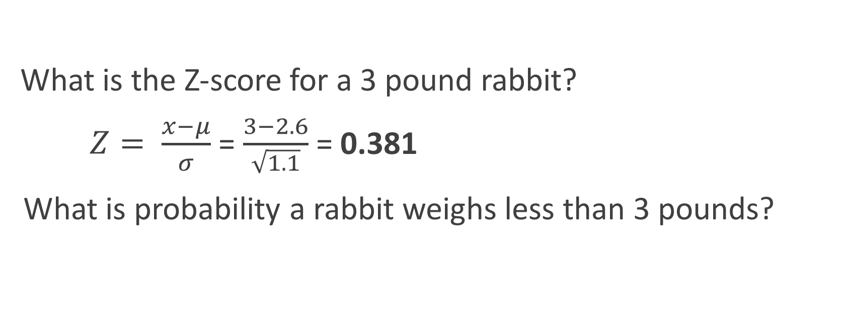
Example: Weight for a population of rabbits follows a normal distribution $N(2.6, 1.1)$
What is the Z-score for a 3 pound rabbit?
$Z= \frac{x−μ}{σ}$ = $\frac{3−2.6}{\sqrt{1.1}}$ = 0.381
What is probability a rabbit weighs less than 3 pounds?
Does is make sense that this number is positive?
pnorm(0.381) = 0.648
pnorm(3, 2.6, sqrt(1.1)) = 0.648
THE FUTURE IS NOW

Slide 63
Normal distributions functions, revisited
All functions assume standard normal. Provide additional arguments for other normals:
Standard normal | Any normal
pnorm(q) = pnorm(q, 0, 1) | pnorm(q, mean, sd)

Slide 64
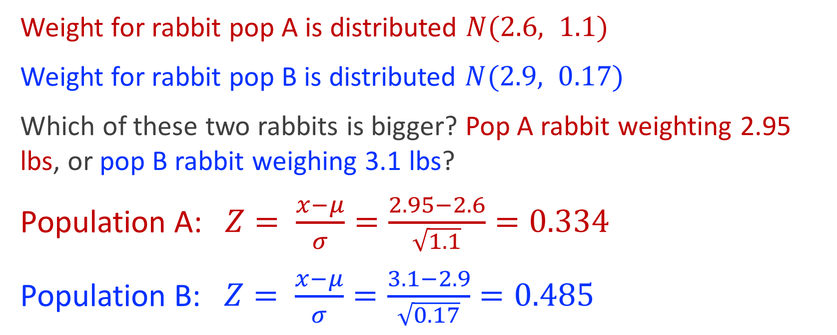
Z-scores are most useful for comparing different distributions
Weight for rabbit pop A is distributed $N(2.6, 1.1)$
Weight for rabbit pop B is distributed $N(2.9, 0.17)$
Which of these two rabbits is bigger? Pop A rabbit weighting 2.95 lbs, or pop B rabbit weighing 3.1 lbs?
Population A: $Z= \frac{x−μ}{σ}=\frac{2.95−2.6}{\sqrt{1.1}}=0.334$
Population B: $Z= \frac{x−μ}{σ}=\frac{3.1−2.9}{\sqrt{0.17}}=0.485$

Slide 65
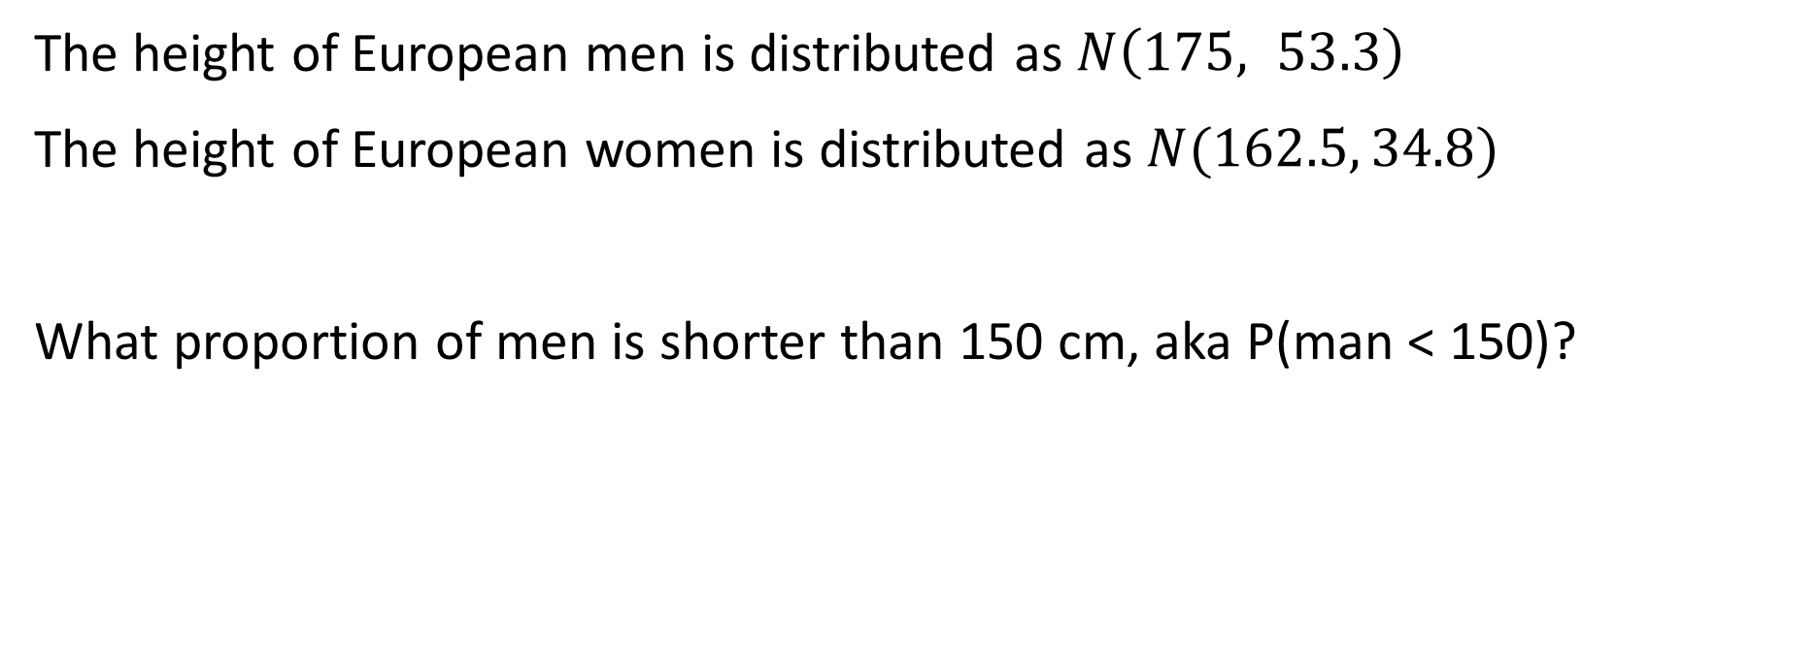
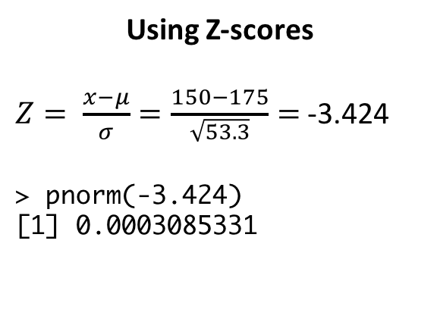
Putting it all together
The height of European men is distributed as $N\left(175, 53.3\right)$
The height of European women is distributed as $N(162.5, 34.8)$
What proportion of men is shorter than 150 cm, aka P(man < 150)?
Using Z-scores
$Z= \frac{x−μ}{σ}=\frac{150−175}{\sqrt{53.3}}=$ -3.424
> pnorm(-3.424)
[1] 0.0003085331
Skipping Z-scores
> pnorm(150, 175, sqrt(53.3))
[1] 0.0003081516
Notes:
5331

Slide 66
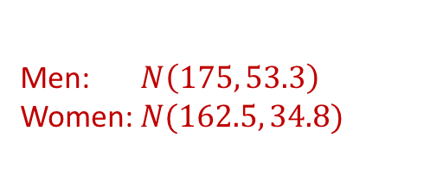
Putting it all together
Men: $N\left(175, 53.3\right)$
Women: $N(162.5, 34.8)$
What proportion of women is taller than 162.5 cm?
50%
Notes:
5331

Slide 67
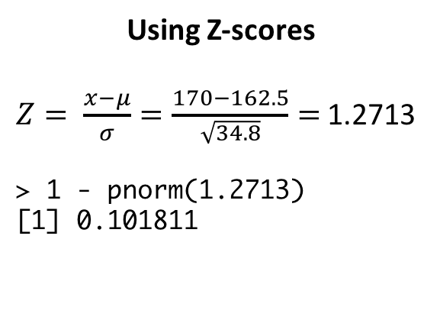
Putting it all together
Men: $N\left(175, 53.3\right)$
Women: $N(162.5, 34.8)$
What proportion of women is taller than 170 cm?
Using Z-scores
$Z= \frac{x−μ}{σ}=\frac{170−162.5}{\sqrt{34.8}}=$ 1.2713
> 1 - pnorm(1.2713)
[1] 0.101811
Skipping Z-scores
> 1 - pnorm(170, 162.5, sqrt(34.8))
[1] 0.1017987
Notes:
5331

Slide 68
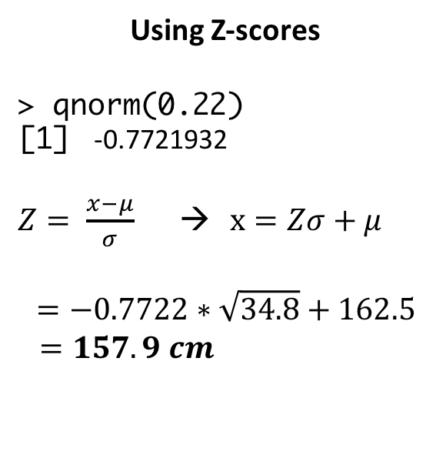
Putting it all together
Men: $N\left(175, 53.3\right)$
Women: $N(162.5, 34.8)$
What is the tallest a woman can be and still be in the bottom 22%?
Using Z-scores
> qnorm(0.22)
[1] -0.7721932
$Z= \frac{x−μ}{σ}$ → $x=Zσ+μ$
$$=−0.7722∗\sqrt{34.8}+162.5$$
$=157.9 cm$
Skipping Z-scores
> qnorm(0.22, 162.5, sqrt(34.8))
[1] 157.9447
Notes:
5331

Slide 69
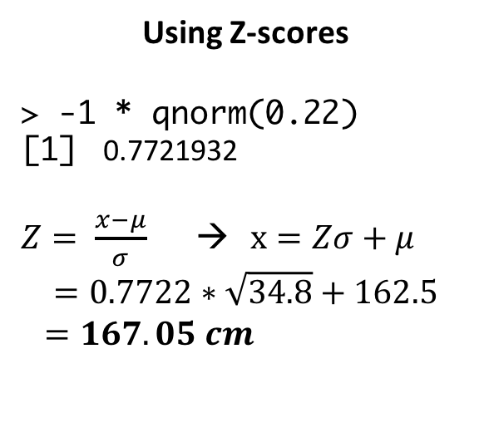
Putting it all together
Men: $N\left(175, 53.3\right)$
Women: $N(162.5, 34.8)$
What is the shortest a woman can be and still be in the top 22%?
Using Z-scores
> -1 * qnorm(0.22)
[1] 0.7721932
$Z= \frac{x−μ}{σ}$ → $x=Zσ+μ$
$$=0.7722∗\sqrt{34.8}+162.5$$
$=167.05 cm$
Skipping Z-scores
> qnorm(1-0.22, 162.5, sqrt(34.8))
[1] 167.0553
Notes:
5331

Slide 70
Putting it all together
Men: $N\left(175, 53.3\right)$
Women: $N(162.5, 34.8)$
What is the probability a randomly chosen man is between 175–182 cm tall?
→ P(X<182) – P(X<175) = P(X<182) – 0.5
> pnorm(182, 175, sqrt(53.3)) – 0.5
[1] 0.3311738
Notes:
5331

Slide 71
Putting it all together
Men: $N\left(175, 53.3\right)$
Women: $N(162.5, 34.8)$
What is the probability a randomly chosen man is either between 175–182 cm tall or between 150—160 cm tall?
→ P(175 < X < 182) + P(150 < X < 160)
### First probability
> pnorm(182, 175, sqrt(53.3)) – 0.5
[1] 0.3311738
> ### Second prob.
> pnorm(160, 175, sqrt(53.3)) – pnorm(150, 175, sqrt(53.3))
[1] 0.01965059
> 0.3311738 + 0.01965059
[1] 0.3508244
Notes:
5331

Slide 72
Putting it all together
Men: $N\left(175, 53.3\right)$
Women: $N(162.5, 34.8)$
I have two randomly-chosen European friends, one man and one woman each. What is the probability the man is at least 180 cm and the woman is between 163—170 cm?
→ P(man > 180) x P(163 < woman < 170)
### First probability
> 1 - pnorm(180, 175, sqrt(53.3))
[1] 0.2467138
> ### Second prob.
> pnorm(170, 162.5, sqrt(34.8)) – pnorm(163, 162.5, sqrt(34.8))
[1] 0.3644282
> 0.246713*0.3644282
[1] 0.08990917
Notes:
5331

Slide 73
Putting it all together
Men: $N\left(175, 53.3\right)$
Women: $N(162.5, 34.8)$
I have two new randomly-chosen European friends, one man and one woman each. What is the probability the man is 180 cm and the woman is 163 cm?
→ P(man = 180) x P(woman = 163)
→ 0
Notes:
5331

Slide 74
Putting it all together
Men: $N\left(175, 53.3\right)$
Women: $N(162.5, 34.8)$
Assume 50.8% of Europeans are women. If a randomly-chosen person is shorter than 155 cm tall, what is the probability the person is a woman?
→ P(woman | < 155) =
P(<155 | woman) * P(woman) / P(<155)
0.102
0.508
### P(<155 | woman)
> pnorm(155, 162.5, sqrt(34.8))
[1] 0.1017987
Notes:
5331

Slide 75
Solving the denominator
P(<155) = P(<155 and man) + P(<155 and woman) =
P(<155|man)*P(man) + P(<155|woman)*P(woman)
0.0031
0.492
0.102
0.508
### P(<155 | man)
> pnorm(155, 175, sqrt(53.3))
[1] 0.003076926
= 0.0533

Slide 76
Putting it all together
Men: $N\left(175, 53.3\right)$
Women: $N(162.5, 34.8)$
Assume 50.8% of Europeans are women. If a randomly-chosen person is shorter than 155 cm, what is the probability the person is a woman?
→ P(woman | < 155) =
P(<155 | woman) * P(woman) / P(<155)
0.102
0.508
0.533
= 0.972
Notes:
5331

Slide 77
BREAK

Slide 78
Statistical inference

Slide 79
Two main flavors of statistical inference
Estimation
Estimate a population parameter from sample data
Point estimates: What is the population mean?
Interval estimates: In what range of values is the population mean likely to fall?
Hypothesis testing
Test whether the value of a population parameter is equal to some specific value
Is there evidence that my sample differs from some underlying population?

Slide 80
The sampling distribution
The probability distribution of values for an estimate that we obtain under sampling

Slide 81
Obtaining a sampling distribution
> genes <- read.csv("genes.csv")
> head(genes)
nucleotides
1 3785
2 7416
3 2135
4 7682
5 5766
6 11079
> mean(genes$nucleotides)
[1] 2761.039
> sd(genes$nucleotides)
[1] 2037.645
> ggplot(genes, aes(x=nucleotides)) + geom_histogram(fill="white", color="black")

Slide 82
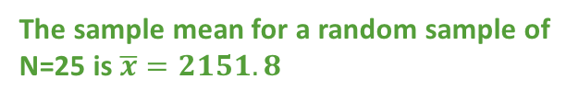
Obtaining a sampling distribution
### the function sample_n draws a random sample of rows
> small.sample <- genes %>% sample_n(25)
> mean(small.sample$nucleotides)
[1] 2151.8
> ggplot(small.sample , aes(x = nucleotides)) + geom_histogram() +
geom_vline(xintercept=2151.8, color="blue") +
geom_vline(xintercept= 2761.039, color="red")
The sample mean for a random sample of N=25 is $\overline{x}=2151.8$
geom_vline(xintercept=…)
geom_hline(yintercept=…)
geom_abline(yintercept=…, slope=…)

Slide 83
Obtaining a sampling distribution
Now imagine we draw 20 samples of N=25 and compute each of their means:
Sampling distribution of the mean
> head(n20.means)
sample.mean
1 2584.84
2 2574.12
3 2382.64
4 3143.68
5 2252.56
6 2368.44

Slide 84
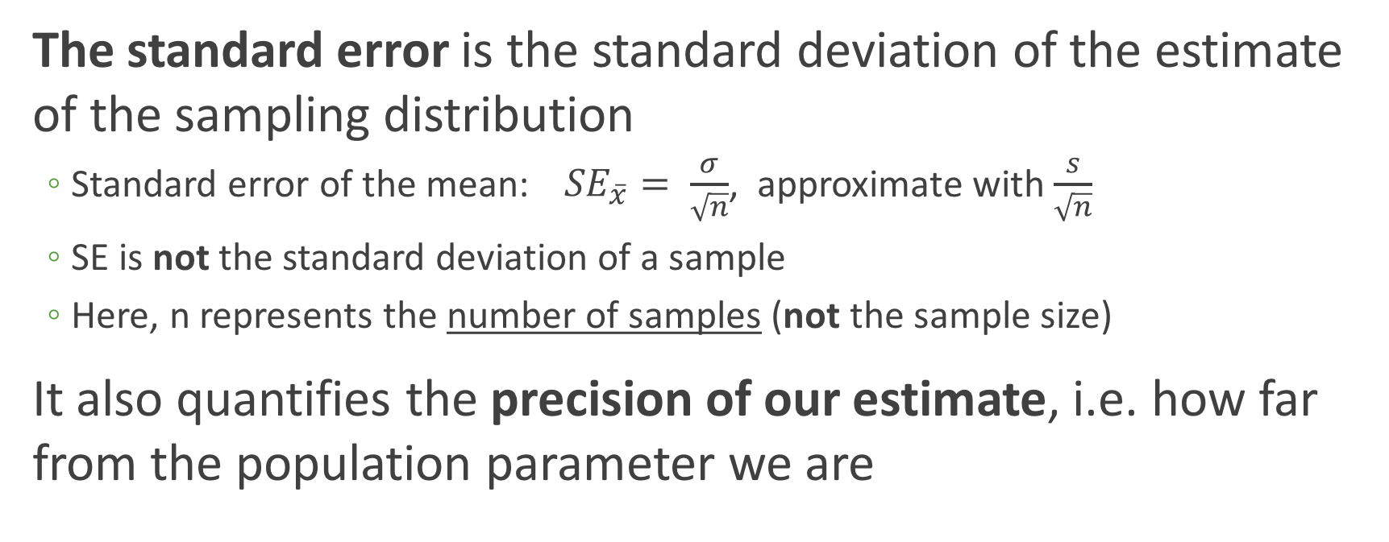
Quantifying the sampling distribution
The standard error is the standard deviation of the estimate of the sampling distribution
Standard error of the mean:${SE}_{\overline{x}}= \frac{σ}{\sqrt{n}}$, approximate with$\frac{s}{\sqrt{n}}$
SE is not the standard deviation of a sample
Here, n represents the number of samples (not the sample size)
It also quantifies the precision of our estimate, i.e. how far from the population parameter we are

Slide 85
Computing the standard error of the mean
> head(n20.means)
sample.mean
1 2584.84
2 2574.12
3 2382.64
4 3143.68
5 2252.56
6 2368.44
> sd(n20.means$sample.mean) / sqrt(20)
[1] 93.11888
Sampling distribution of the mean

Slide 86
Several sampling distributions comprised of N samples, each of n=25
N=20
N=50
N=100
N=1000
N=10000

Slide 87
Standard error decreases as N increases
N=20
N=50
N=100
N=1000
N=10000
SE = 93.1
SE = 58.1
SE = 37.9
SE = 13.3
SE = 4.02

Slide 88
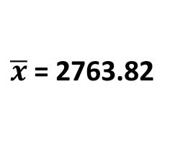
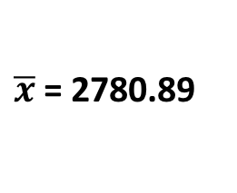
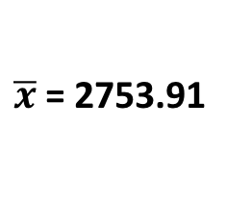
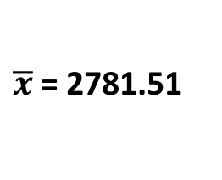
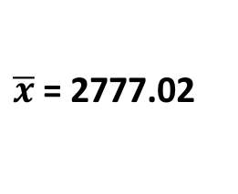
Therefore, mean of sampling distribution approaches population mean 2761.039
N=20
N=50
N=100
N=1000
N=10000
SE = 93.1
SE = 58.1
SE = 37.9
SE = 13.3
SE = 4.02
$\overline{x}$= 2780.89
$\overline{x}$= 2753.91
$\overline{x}$= 2781.51
$\overline{x}$= 2777.02
$\overline{x}$= 2763.82

Slide 89
The Central Limit Theorem
As sample size increases, the sampling distribution of the mean will be approximately normal regardless of true population distribution
Population distribution
N=1e4 sampling distribution

Slide 90
Next week..
Introduction to hypothesis testing and comparing means
More fun facts on estimation will come later in the semester, to be bundled with *likelihood*

